Slide 1

Microwave Tracking Ground Station (MTGS)
Team Members: Clay Edwards Christian Ogburn Jared O’Shea Jusefs Saade Jordan West Ian Wolfe
Product Owner: Dr. Eduardo Rojas

Slide 2
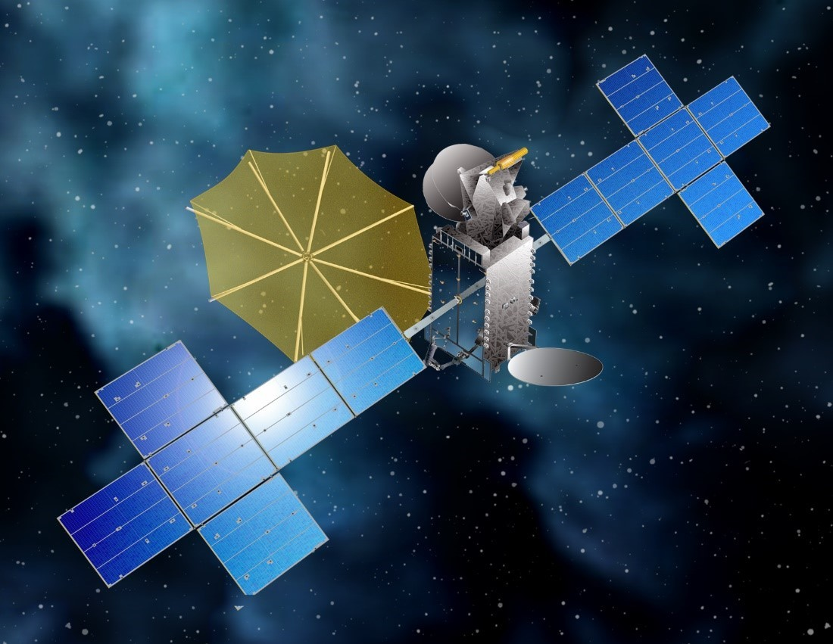
Introduction
Ground stations are a key part in satellite communications
Global Connectivity
Emergency Response
Navigation and Mapping
Commercial Applications (such as our STMGS)
Space Exploration
Sirius XM SXM-8 Satellite

Slide 3
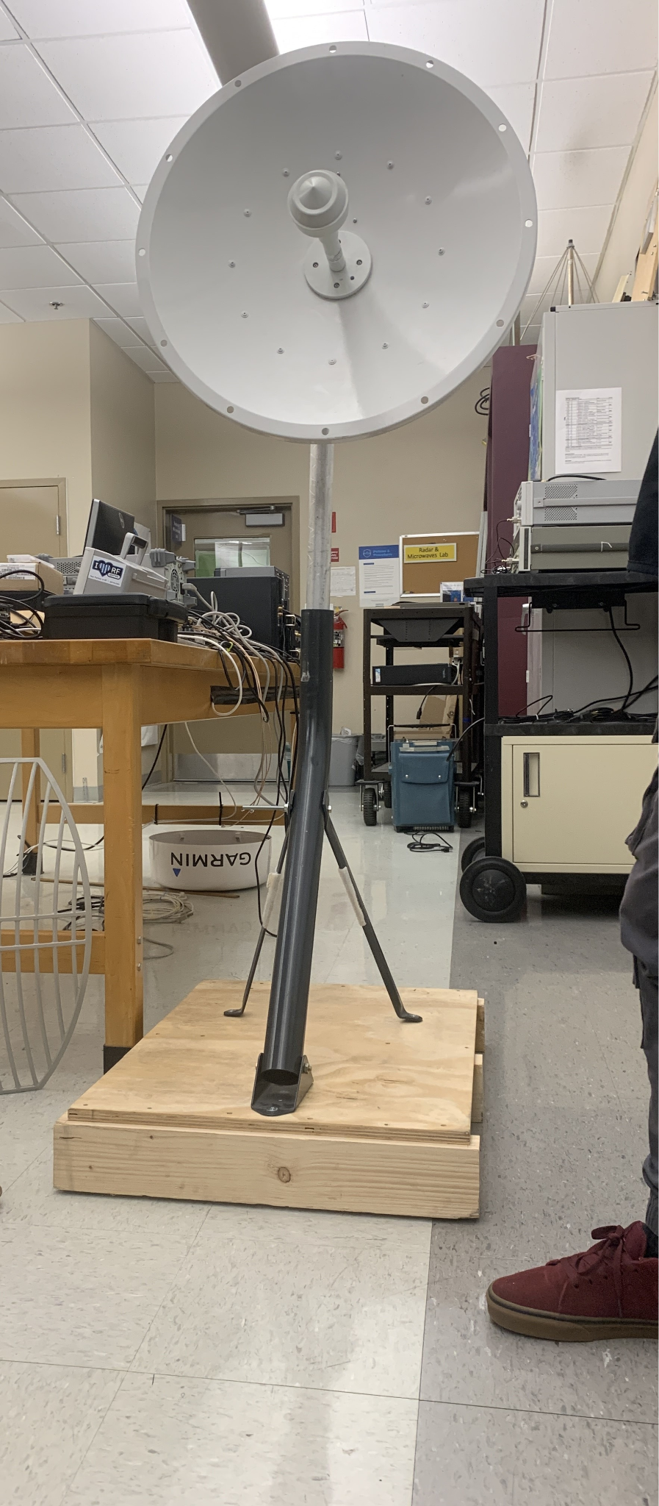
Change of Product Scope
Our contingency plan has been put into full effect
No longer receiving any new parts
Using all hardware from old ground station, except…
Manufacturing our own RF Block
Using new SDR module (Pluto)
All software is new as well

Slide 4
Design/Safety Considerations
General Project Constraints
Available components for this ground station are those in the ERAU WiDE Lab
Gain/Loss
Size
Meteorological/Geographic Conditions
RocketDish 2.4 GHz WiFi Antenna
Safety Considerations
Personal/Hardware safety concern:
Never exceed voltage or amperage ratings

Slide 5
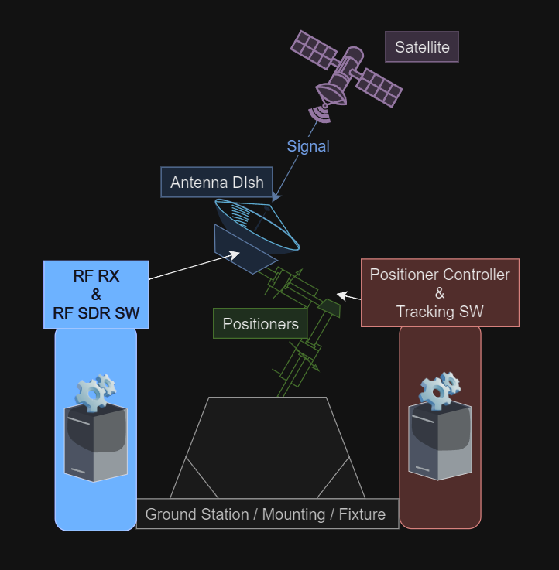
Summary of Project
Our mission is to track and receive signals from an S-Band frequency satellite.
The system is composed of five subsystems: A mount, positioner, tracking software, antenna, and software-defined radio (SDR)
Our focus this semester is tracking, setting up arriving hardware for testing and testing existing hardware

Slide 6
Project Timeline
SPRINT 1
Scope Change?
Parts
Early Software
RF Block Research
SPRINT 2
Full Scope Change
RF Block Design
Software Testing and Confirmation
Demodulation Research
SPRINT 3
RF Block Manufacturing
Satellite Point & Track
Record signals
Demodulation

Slide 7
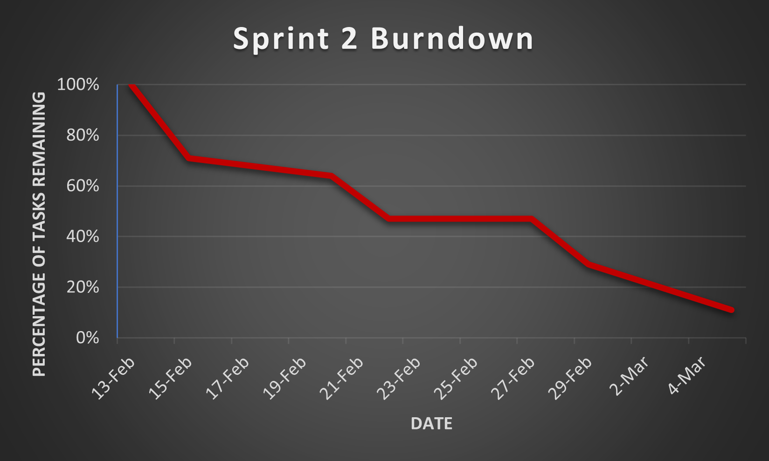
Scrum & Backlog Progress
Notes:
A lot of backlog changes and shifting due to scope change
Much better process with deadlines and assignments on every task
Some delays due to scope change causing large documentation changes
Trello app, very convenient for reminders

Slide 8
Antenna RF Block Design
Objective: optimize signal reception by our antenna, to ensure high-quality communication.
Components: Low Noise Amplifier (LNA), Bandpass Filter, Circular Polarization.
Circular Polarizer (90 deg shift)
Bandpass Filter
Incoming Signal
LNA
SDR
S-Band Antenna
RF Block
To Do:
Analyze current antenna.
Perform RF Block design (polarizer, coupled-line filter) using Ansys, ADS.
Revise link budget

Slide 9
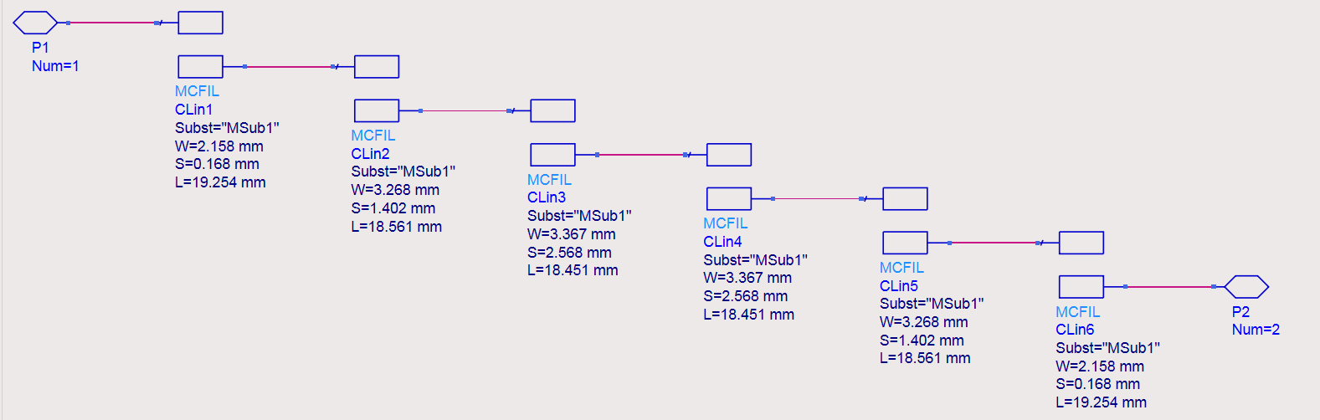
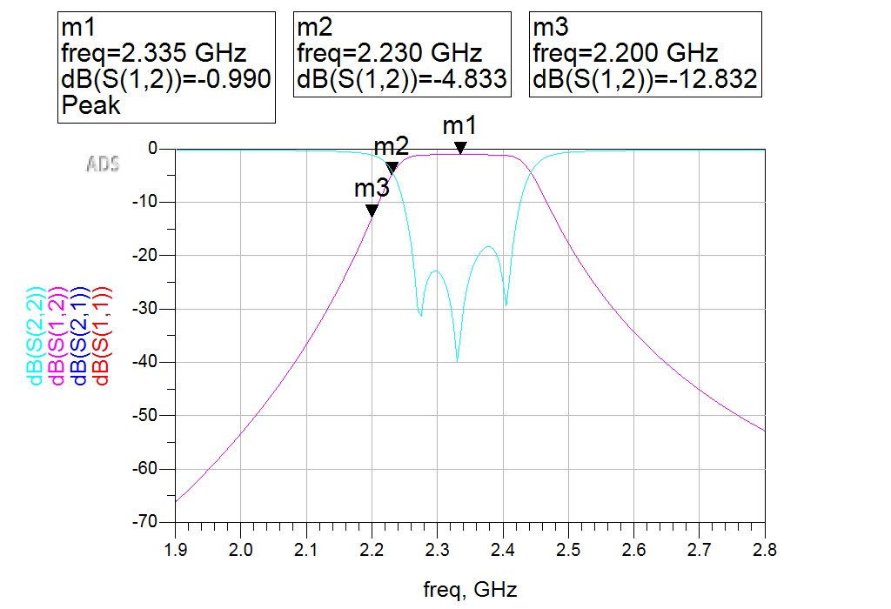
Coupled-Line Bandpass Filter
2.2-2.5 GHz
Butterworth
6th Order
Substrates:
Copper
Rogers RO4003C
To be completed:
Impedance matching using two stubs
Review attenuation at stopband and revise as necessary
Begin manufacturing this week

Slide 10

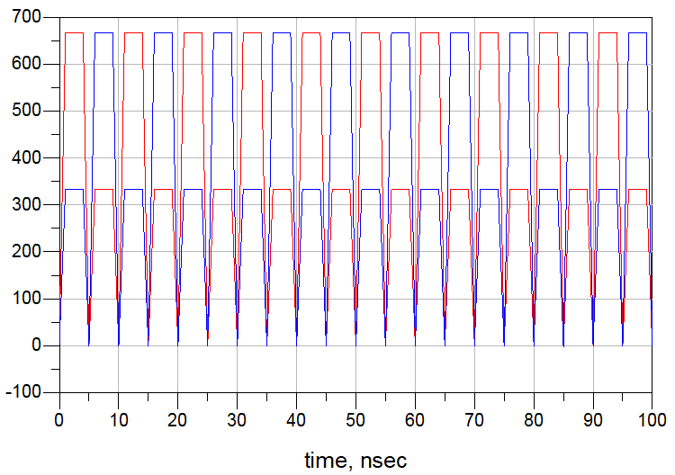
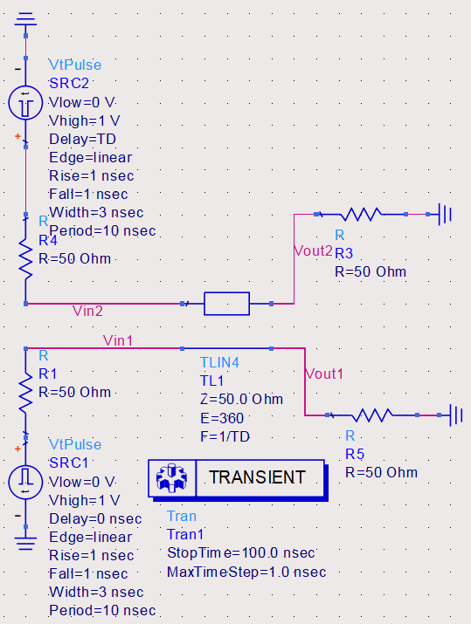
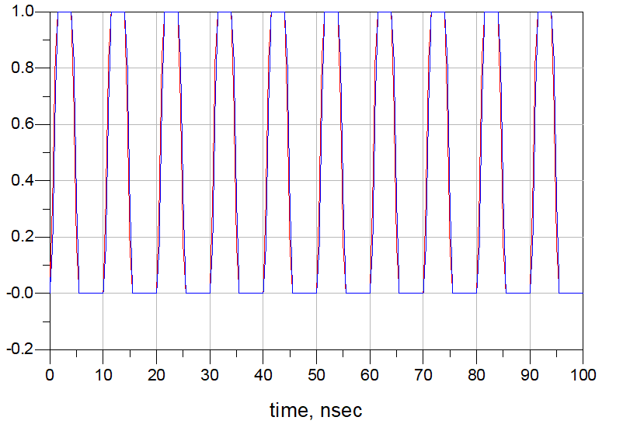
Polarizer Prototype (Delay Line)
To be completed:
Meet lead researcher to validate
Try microstrip line approach
Scale to project requirements
Manufacture in next 2 weeks
Substrates:
Copper
Rogers RO4003C
Frequency:
1 GHz

Slide 11
Project Link Budget Analysis
Objective: ensuring reliable communication between satellite and ground station; calculating necessary signal strength and quality.
Key variables: TX && RX powers, gains, losses, and noise figures.
P_{rx} = P_{tx} + G_{tx} + G_{rx} - L_{tx} - L_{rx} - L_{fs}
L_{fs} = free space path loss = 20 log₁₀( 4π (d ⁄ 𝛌))
LM = (P_{rx} - RS) > 0
RS = receiver sensitivity
To Do:
RF Block && Antenna: Power, gain and loss using MATLAB.
Ensure reliable communication.

Slide 12
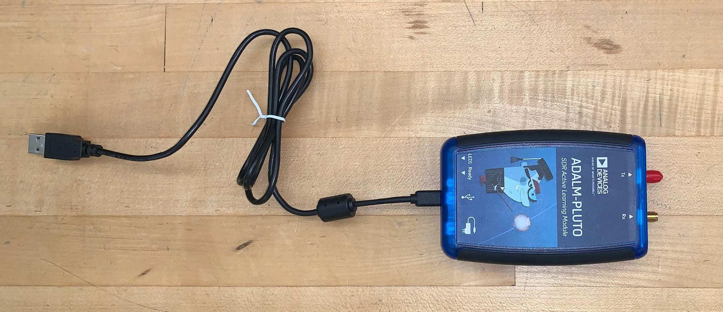
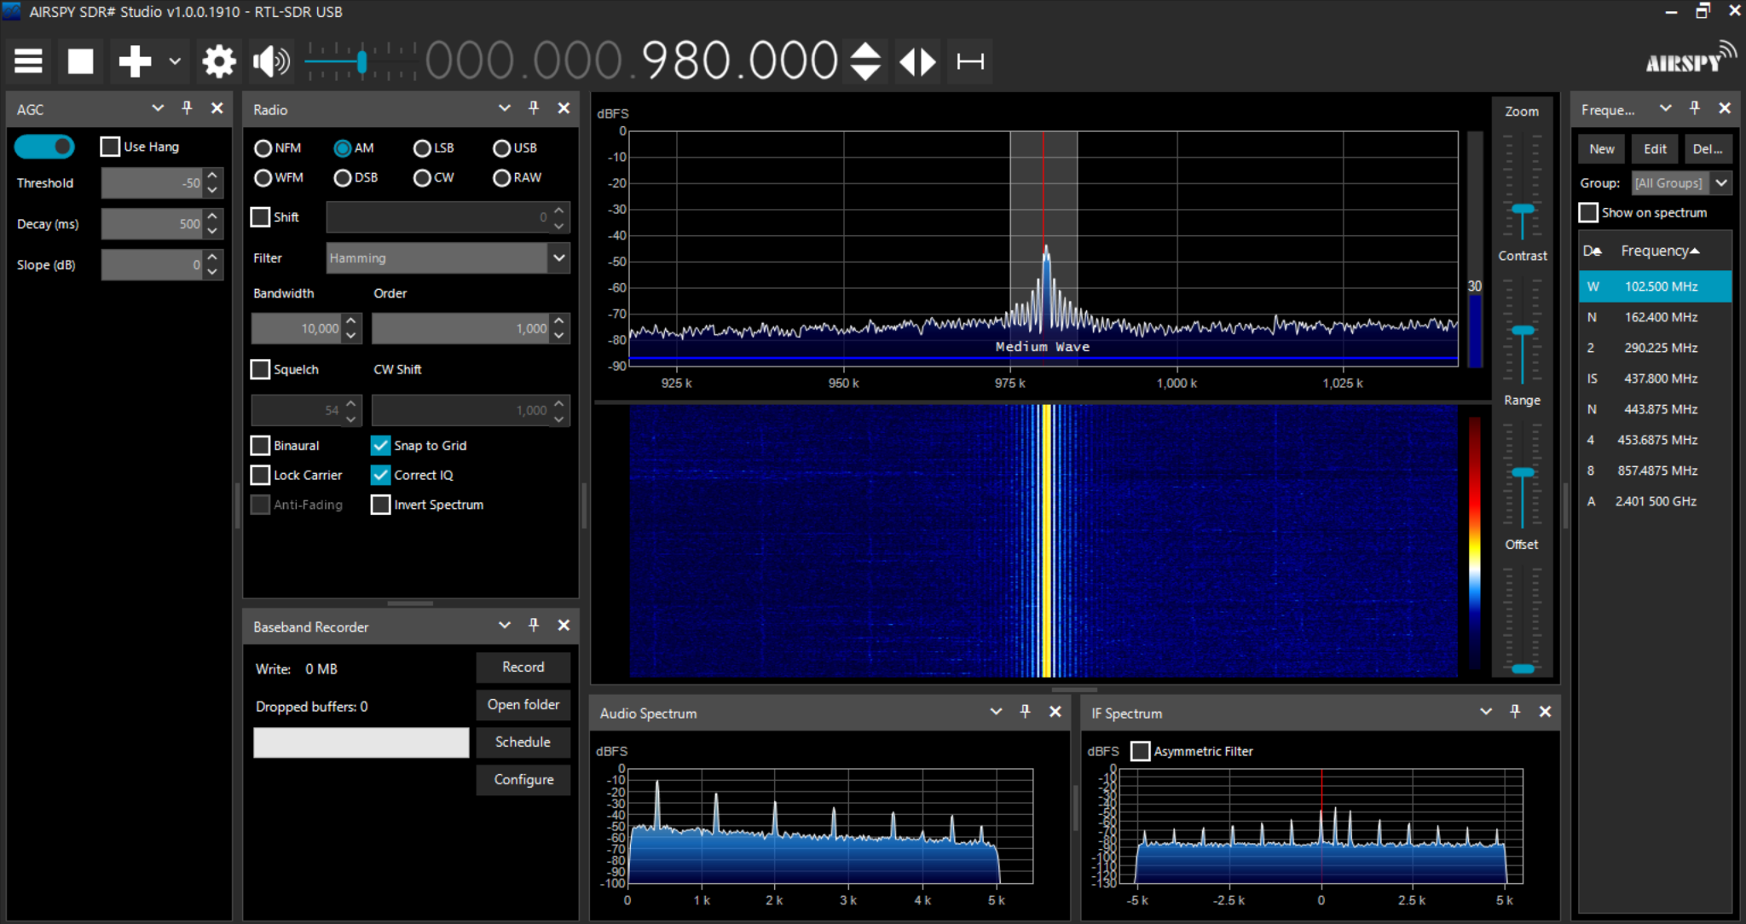
SDR Testing/Software
Working on testing PLUTO SDR - experiencing issues with software compatibility
Software needed to adjust SDR settings and record signals
Currently using SDR# - Good UI with recording features
Turned down MATLAB due to time constraints

Slide 13
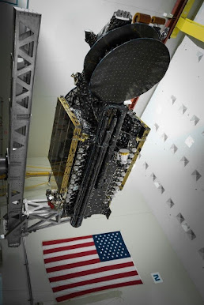
Satellite choice and Modulation
We have chosen SXM 8 a Sirius XM satellite.
The modulation schemes for the XM satellites is Coded Orthogonal Frequency Division Multiplexing: Differential Quadrature Phase Shift Keying (COFDM-DQPSK)

Slide 14
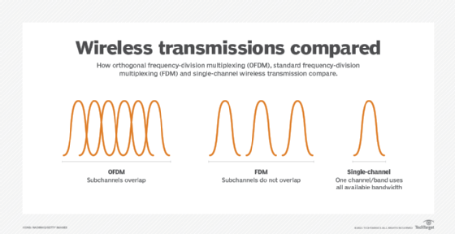
What is COFDM?
COFDM is the division of one digital signal across 1000 other digital carriers simultaneously
The signals are sent at right angles from each other to avoid interference
COFDM applies Forward Error Correction (FEC)

Slide 15
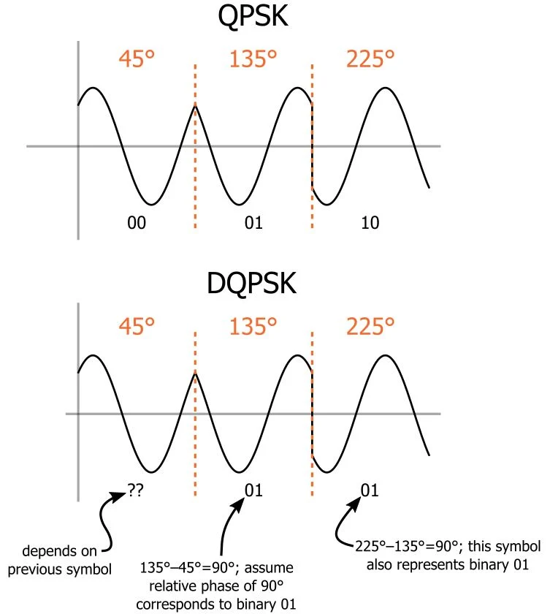
What is DQPSK?
Quadrature Phase Shift Keying (QPSK) enables transmission of two bits per symbol.
DQPSK encodes data based on the phase difference between consecutive symbols.

Slide 16
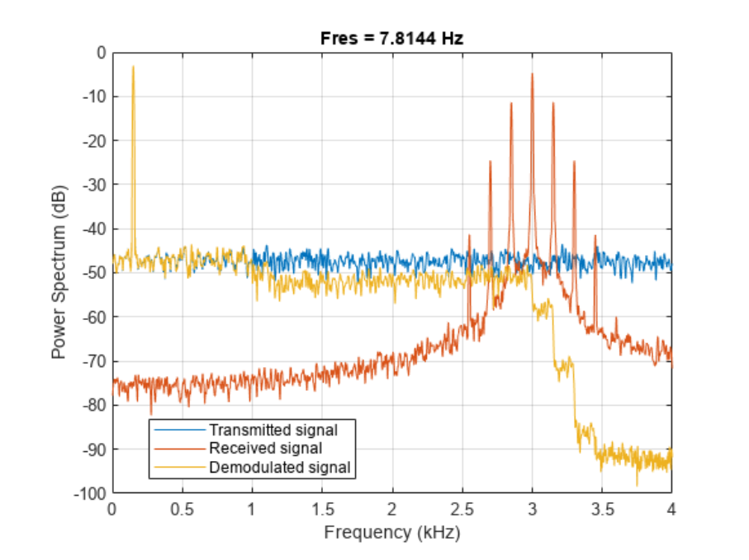
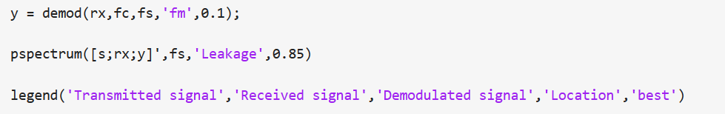

Goals for Demodulation
Currently there is access to two different different pieces of Matlab code that can be used to demodulate COFDM and DQPSK.

Slide 17

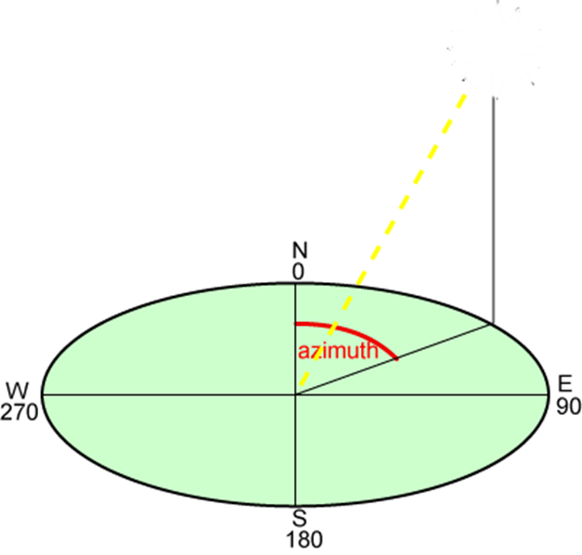
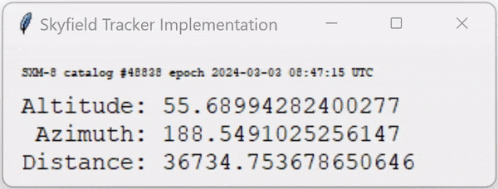
Tracking Software
Tracking Software outputs azimuth and altitude (elevation)
Starting with geostationary to test pointing, then moving to tracking
Ham tracking hardware and software
Python program for checking and testing within 0.0005 arcseconds of the Astronomical Almanac from the United States Naval Observatory

Slide 18
For the tracking demonstration video, follow this link:
https://drive.google.com/file/d/1gMnMoOf3_ebvtcW9oFH6QjS_HROSX8R5/view?usp=sharing

Slide 19
Lessons Learned
Verify datasheet consistency
Plan for budget changes
Plan for non-ideal conditions and parameters
Demodulation is very extensive and will take considerable research to do
Signal file format will be very important when it comes to determining the tracked signal

Slide 20
Thank you! Any questions?

